Slide 1


Boston Apartments Sponsor : Eric Boyer Project Advocate : Dr. Michael Findler
Team-1 : Amit Squared Amit Pandey Amit Sharma Bhavana Vakkalagada Sai Vinay Gangadharabhatla Suraj Atmakuri

Slide 2
Boston Apartments
Bostonapartments.com is a realty website that shows all the empty lots, rentals and open houses in and around the city of Boston.
Bostonapartments.com allows Landlords and Homeowners to post, track and update listings.
Bostonapartments.com also includes features such as, Deals, Activity reports, History and more.

Slide 3
Users
Landlords
Realty Agents
Agencies
Homeowners
Admin

Slide 4
Updated Existing Features
New Features
Displays default location for all clients and users.
Displays the listings and landlords on the system.
Ability to upload pictures and media until size 5MB.
Displays all the clients from the system.
Multiple levels of access for admin, agency, agents and homeowners.
Ability to send mail to all the clients on the website.
Centralized search implemented throughout the website.
Displays multiple locations for all the users and clients.
Status of a client can be changed from active to inactive or vice versa.
Can upload bigger media and files to the website.
Enabled sorting to sort all the tables by clicking on the columns.
Ability to delete users with listings along with any of their listings present.
Added UI for intellirent a rent tracking application.
Made user preferences persist.

Slide 5
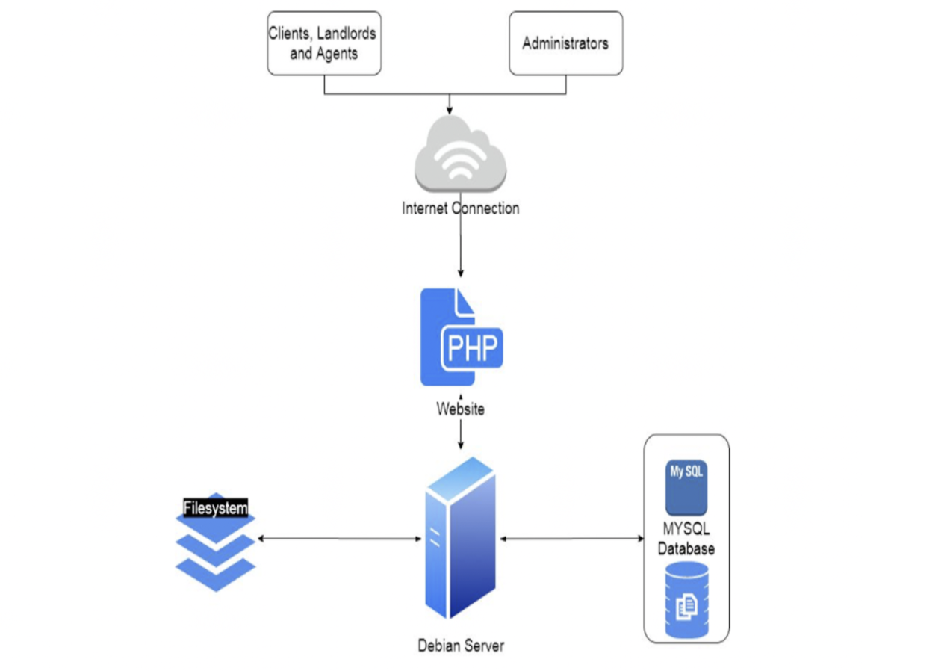
Architecture

Slide 6
Architecture
We are following the Model, View and Controller (MVC) pattern.
For various development requirement we used the Façade Design Pattern.
We have kept all the crucial components modular as to avoid inter dependencies before our sprint release.

Slide 7
Tech Stack
Used LAMP stack to work on the project.
LAMP consists of:
Debian Linux (Environment)
Apache (Webserver)
MySQL (database)
PHP (scripting language)

Slide 8
Challenges Faced
Took time to understand previous version's code.
Not familiar with PHP in the beginning.
Initial setup on our local machines.
Worked simultaneously with UI team (UMass Boston).
Keeping track of everything on the website.

Slide 9
Helping Factors
Daily standups, retrospective meetings and communication
Distribution of tasks among team members based on the skill set.
Frequent meetings with sponsor (Eric).
Documentations provided by the sponsor.

Slide 10
Lessons Learned
Communication is the key
Documentation is the most important task - Documentation is the justification of the project to get an overview about the goal , requirements, resources and lot more.
Version/Code tracking - using GitHub so that further developers can have an idea of what we developed from the previous version.

Slide 11

Thank you Eric and Dr. Findler for your guidance and support.
Video Presentation

